Slide 1
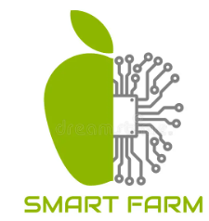


Smart Farm
Kareem Zeedan
Rami Taha
Supervised by: Dr.Naomi Unkelos-Shpigel
Link to GitHub:https://github.com/SharkZeedan/Smart-Farm
Braude College
Software Engineering Department
Capstone Project Phase A
Smart Irrigation System
Code:25-1-D-12

Slide 2
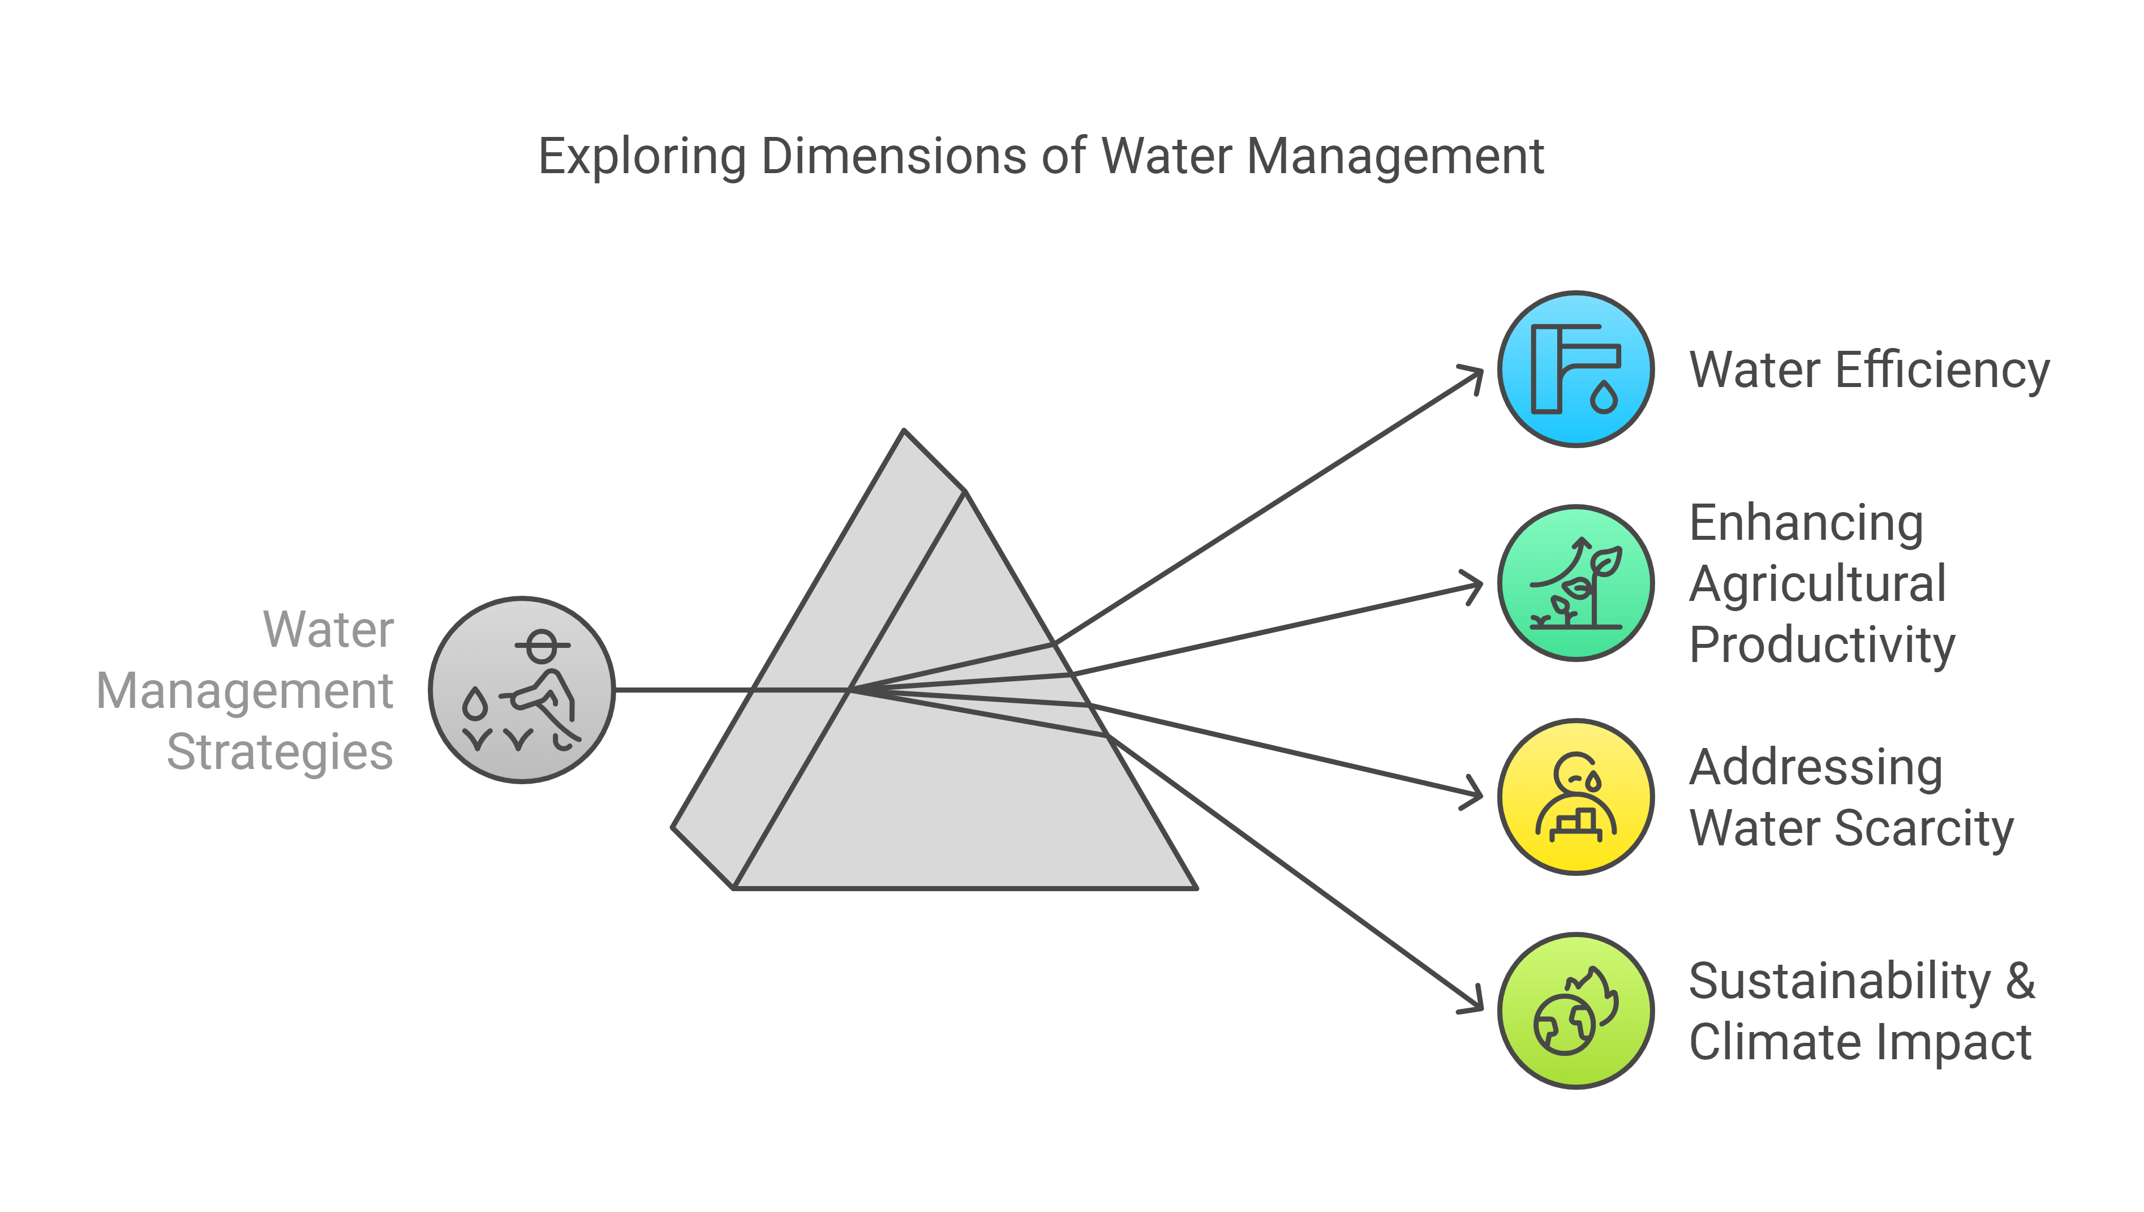
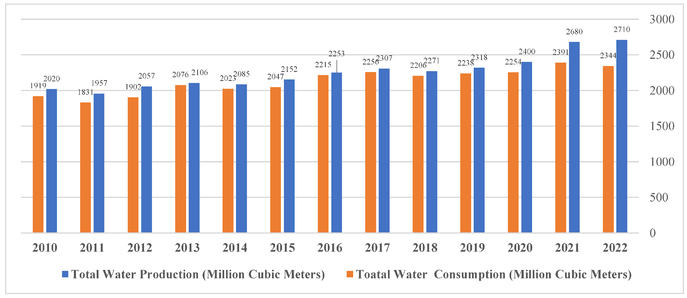
1
Motivation
In Israel:
Consumption is close to production
Water efficiency.
Enhancing Agricultural Productivity.
Water Management
Addressing Water Scarcity.
Climate Impact.
https://www.preprints.org/manuscript/202407.0018/v1

Slide 3

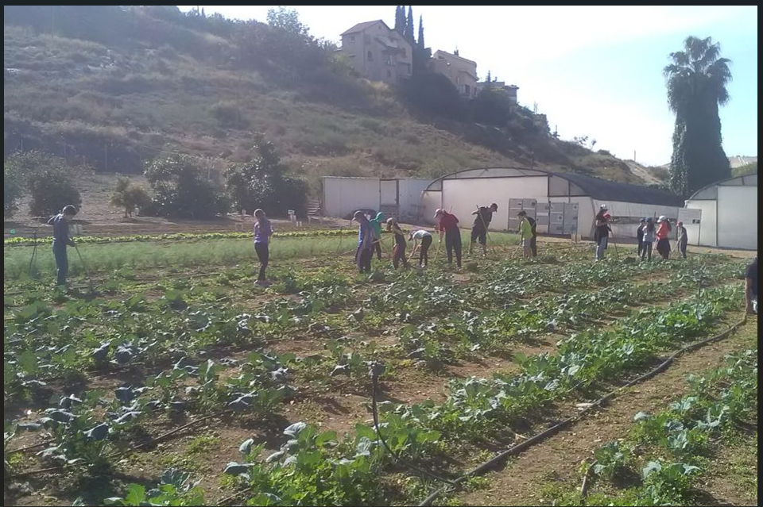
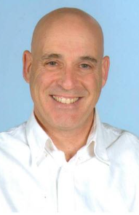
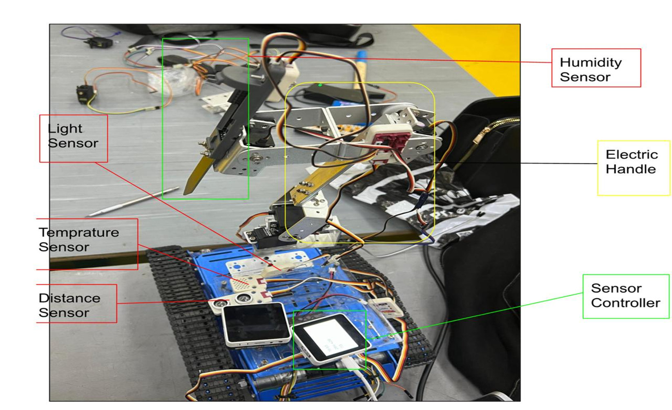
2
Main Characters
Keren Bensamhon Meshrki
Uzi Rosen
Farm Manager: Keren manages the farm in Karmie’l where our project is planned to be deployed.
System Issues: The irrigation system lacks real-time alerts and weather data.
Irrigation Challenges: No guidance on irrigation timing or parameter tracking.
Alert Limitations: Alerts are online-only; she wants WhatsApp notifications.
Uzi's Role: Uzi, a mechanical engineering lecturer, bridges our team with the mechanical side.
Key Support: He supervises students delivering the robot for our project.
Middleman: Acts as the connection between our project and the mechanical team.

Slide 4

3
Challenge and objectives
Challenge:
Water Shortage – Limited water resources threaten agricultural sustainability.
Inefficient Irrigation – Wasteful water use lowers crop yields and harms the environment.
Climate Impact – Poor water management worsens the effects of climate change.
Objectives:
Smart Irrigation – Develop a system that optimizes water usage.
Technology Integration – Utilize real-time sensor data, cloud computing, and weather forecasting.
Sustainable Farming – Enhance productivity while conserving water resources.

Slide 5
4
Requirements
FR Requirements
NFR Requirements
The System should allow users to start/stop irrigation via the web interface. | Manual Irrigation Control
The System should allow users to predict irrigation needs using forecast data. | Weather Forecast Integration
The System should allow users to adapt irrigation based on weather, soil, and plant needs. | Dynamic Irrigation Adjustment
The System should support enough sensors and be expandable to larger farm areas. | Scalability
The System should ensure 99.9% uptime for data transmission and control. | Availability
The System should provide real-time updates with <2s response time. | Performance

Slide 6
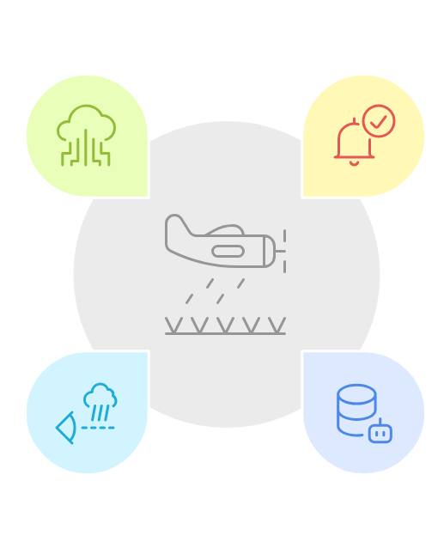
5
Proposed Solution
Our solution integrates advanced technologies to optimize irrigation processes and conserve water
Data Analysis and Storage
Data is securely stored analyzed for insights and improvements.
Alerts and Controls
Generates alerts and offers options for irrigation management.
Predictive Irrigation
Uses weather forecasts to optimize water usage efficiently.
Real-Time Data Collection Sensors monitor environmental conditions continuously for accurate data.

Slide 7
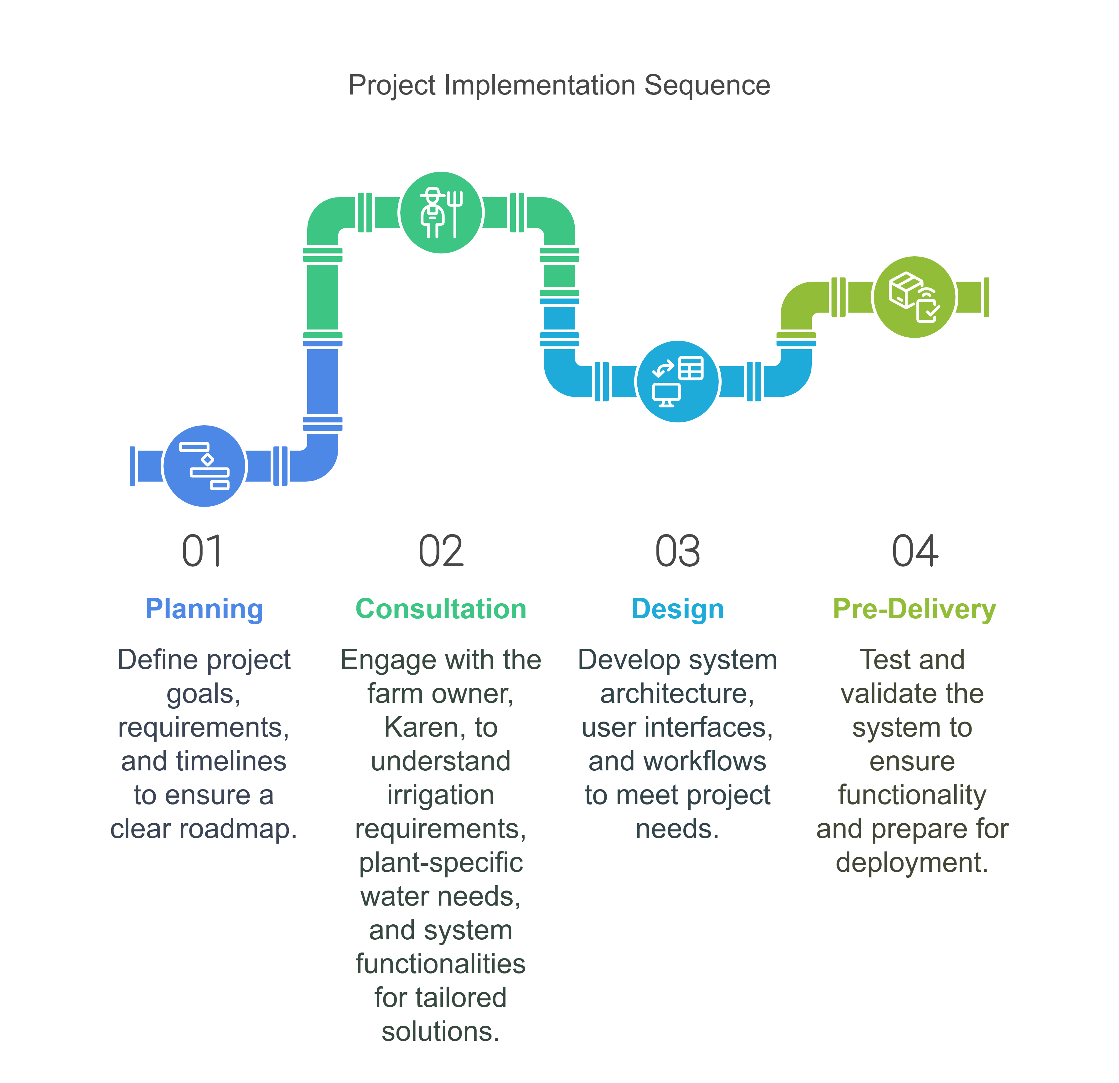
6
Project Workflow
Planning
Define project goals, requirements, and timelines for clear roadmap.
Consultation
Engage with farm owner Keren to understand irrigation needs, plant requirements, and system functionalities.
Design
Develop system architecture, user interfaces, and workflows for project needs.
Pre-Delivery
Test and validate system functionality before deployment.

Slide 8
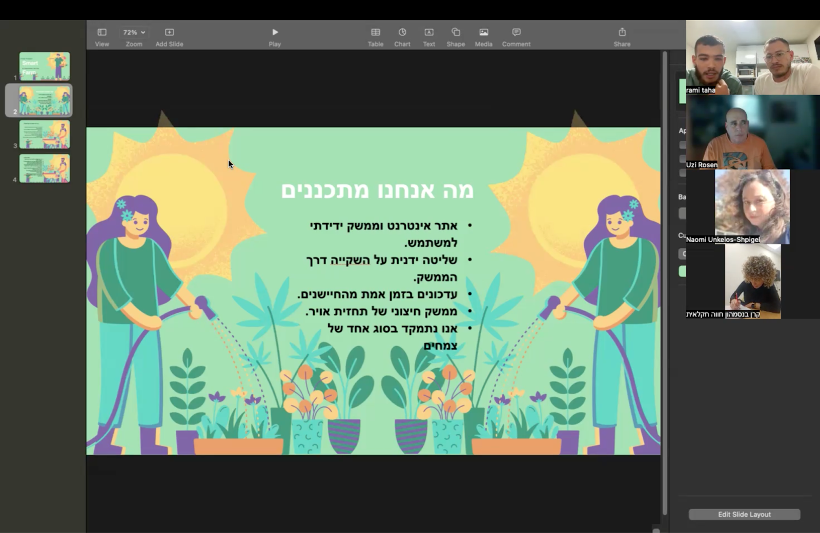
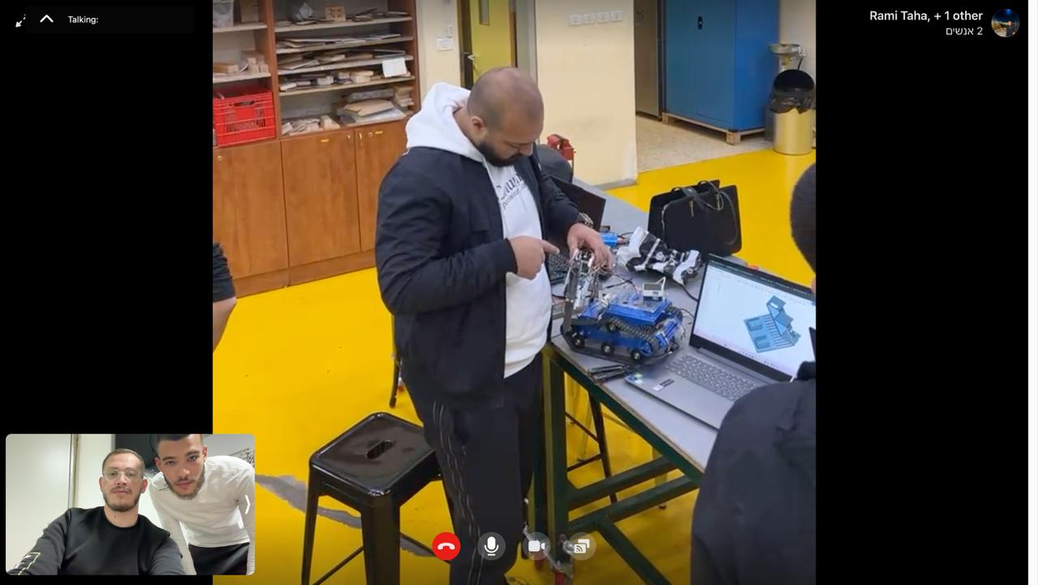
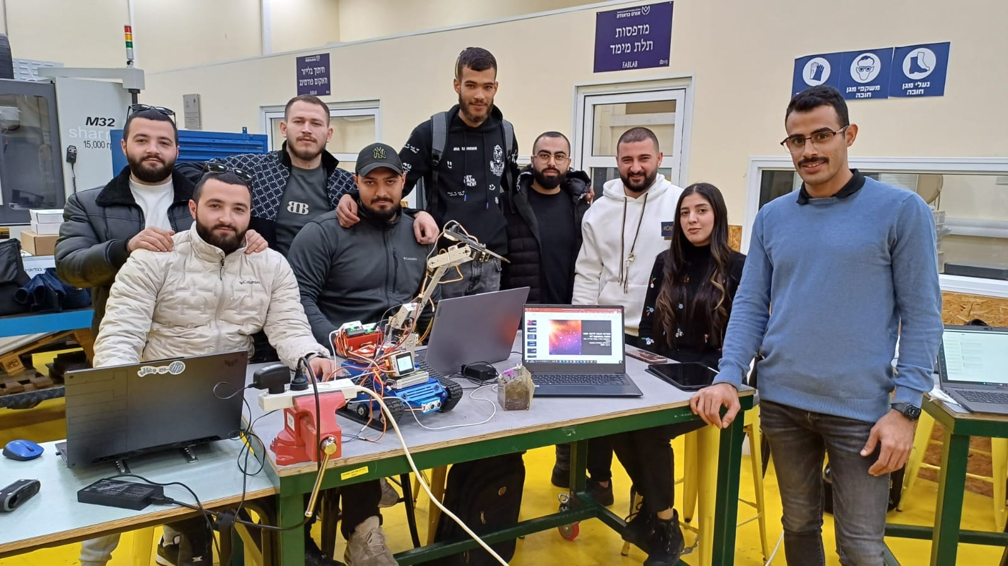
7
Collaboration
Overall look with the whole mechanical team about the final updated version of the robot, ensuring its functioning as planned, combining the handle with the driving robot.
Understanding Keren and Uzi’s POV and setting a clear path of our system functionalities.
Meeting with Omar, our friend from the mechanical team explaining each part of the robot and its functionality.

Slide 9
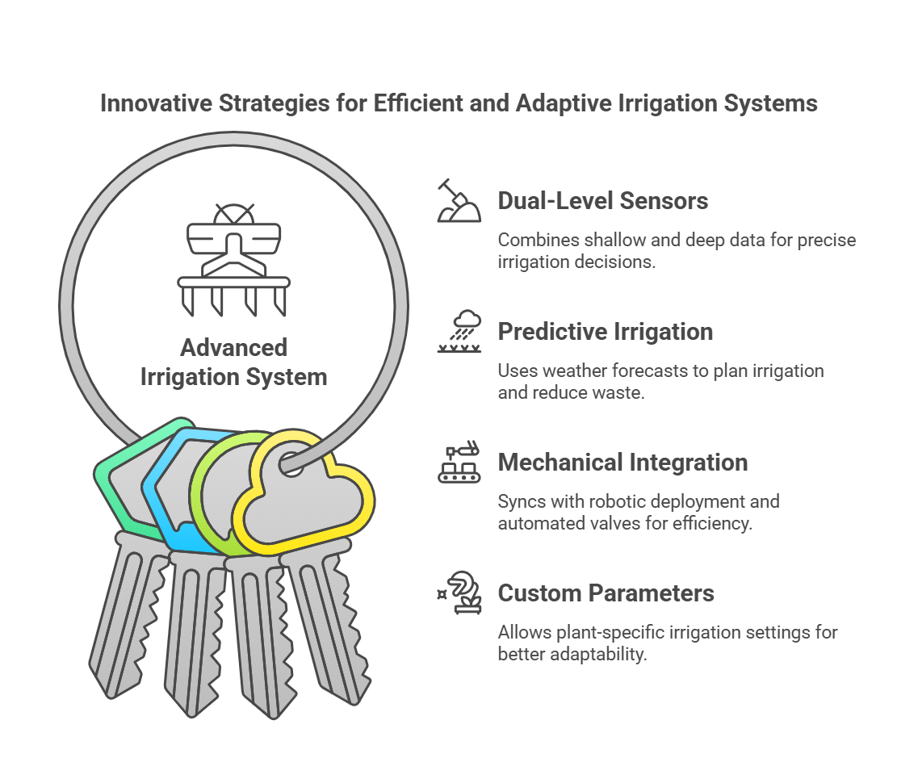
How our Project Differs from Others
8
Dual-Level Sensors
Combines shallow and deep data for precise irrigation decisions.
Predictive Irrigation
Uses weather forecasts to plan irrigation and reduce waste.
Mechanical Integration
Syncs with robotic deployment and automated valves for efficiency.
Custom Parameters
Allows plant-specific irrigation settings for better adaptability.

Slide 10
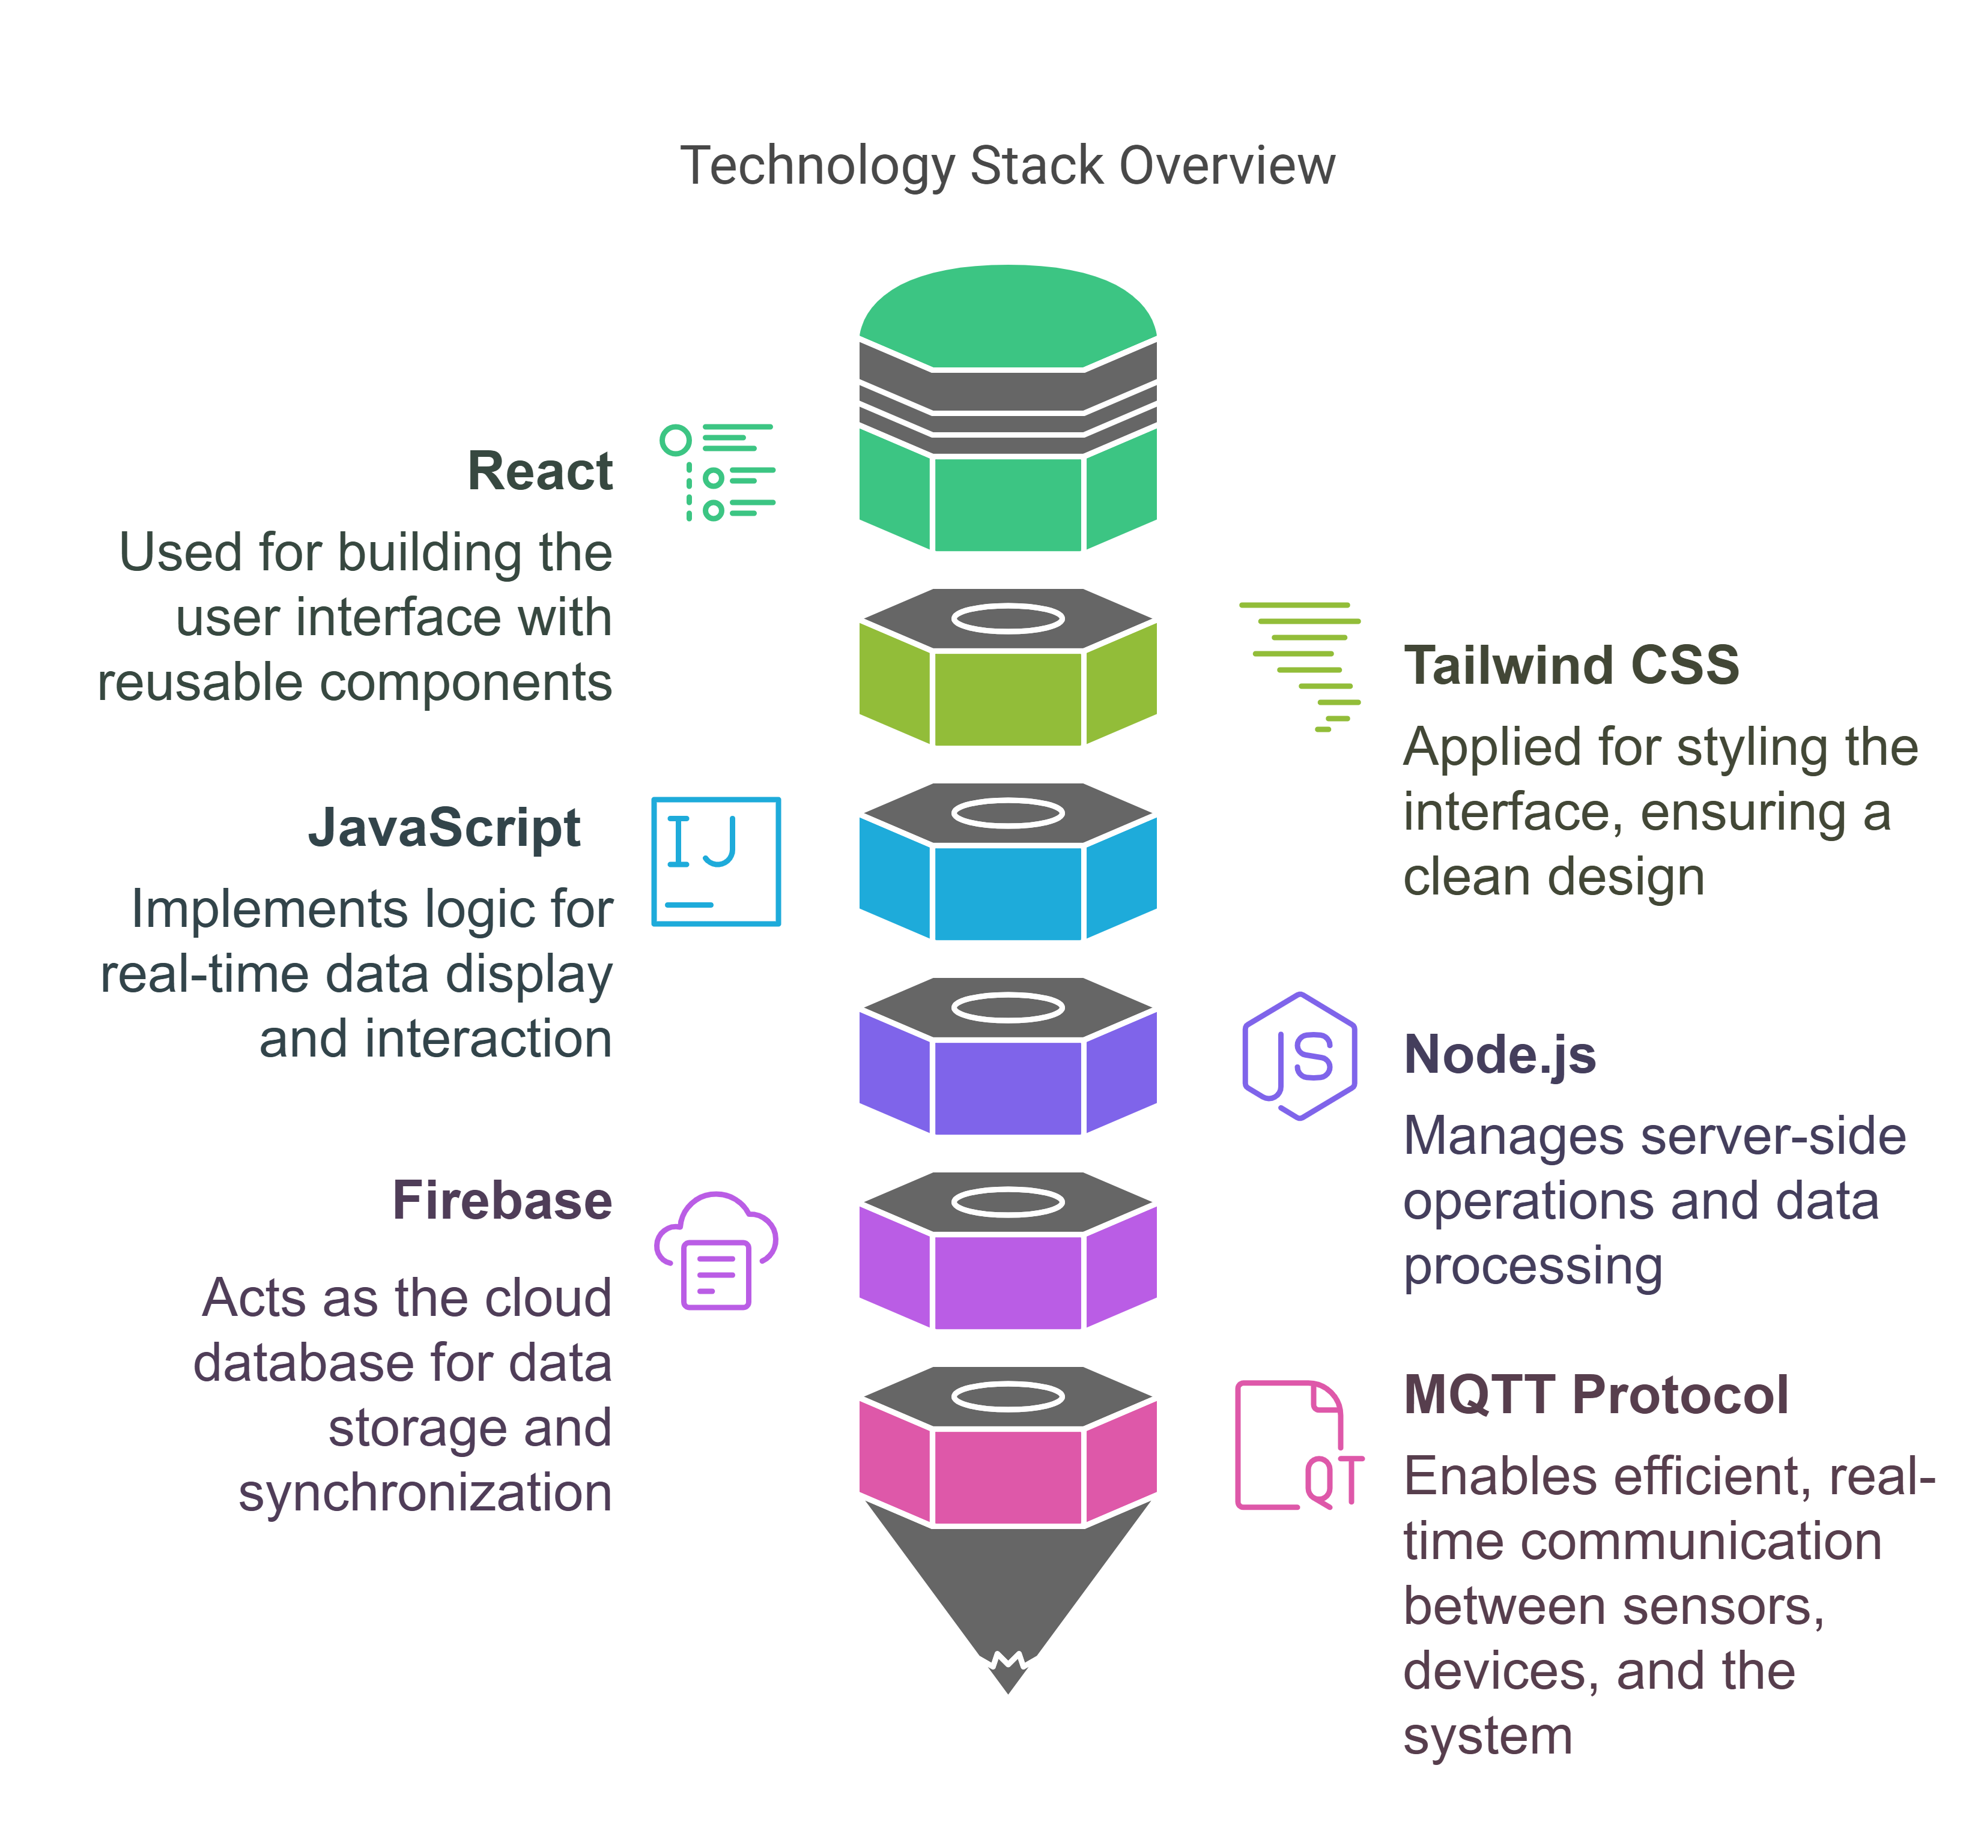
Technological Review
9
React
For building user interface with reusable components.
Tailwind CSS
Applied for styling the interface, ensuring a clean design.
JavaScript
Handles real-time data display and interaction logic.
Node.js
Manages server-side operations and data processing.
Firebase
Cloud database for data storage and synchronization.
MQTT Protocol
Enables real-time communication between sensors, devices, and system.

Slide 11
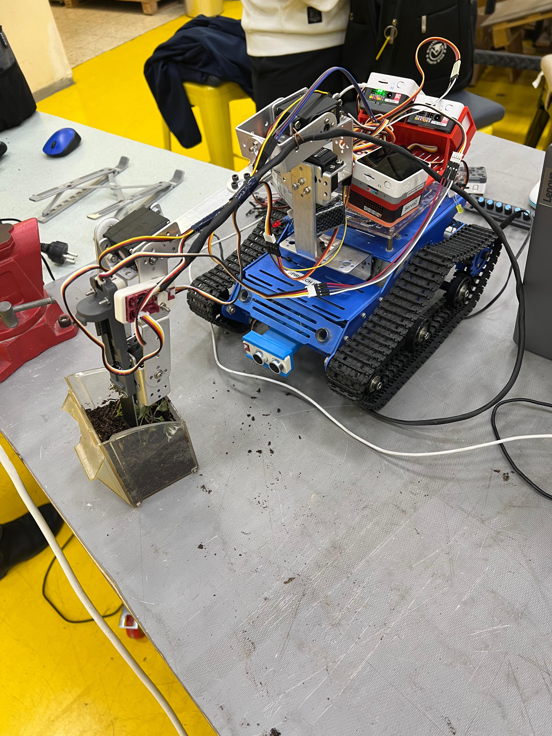
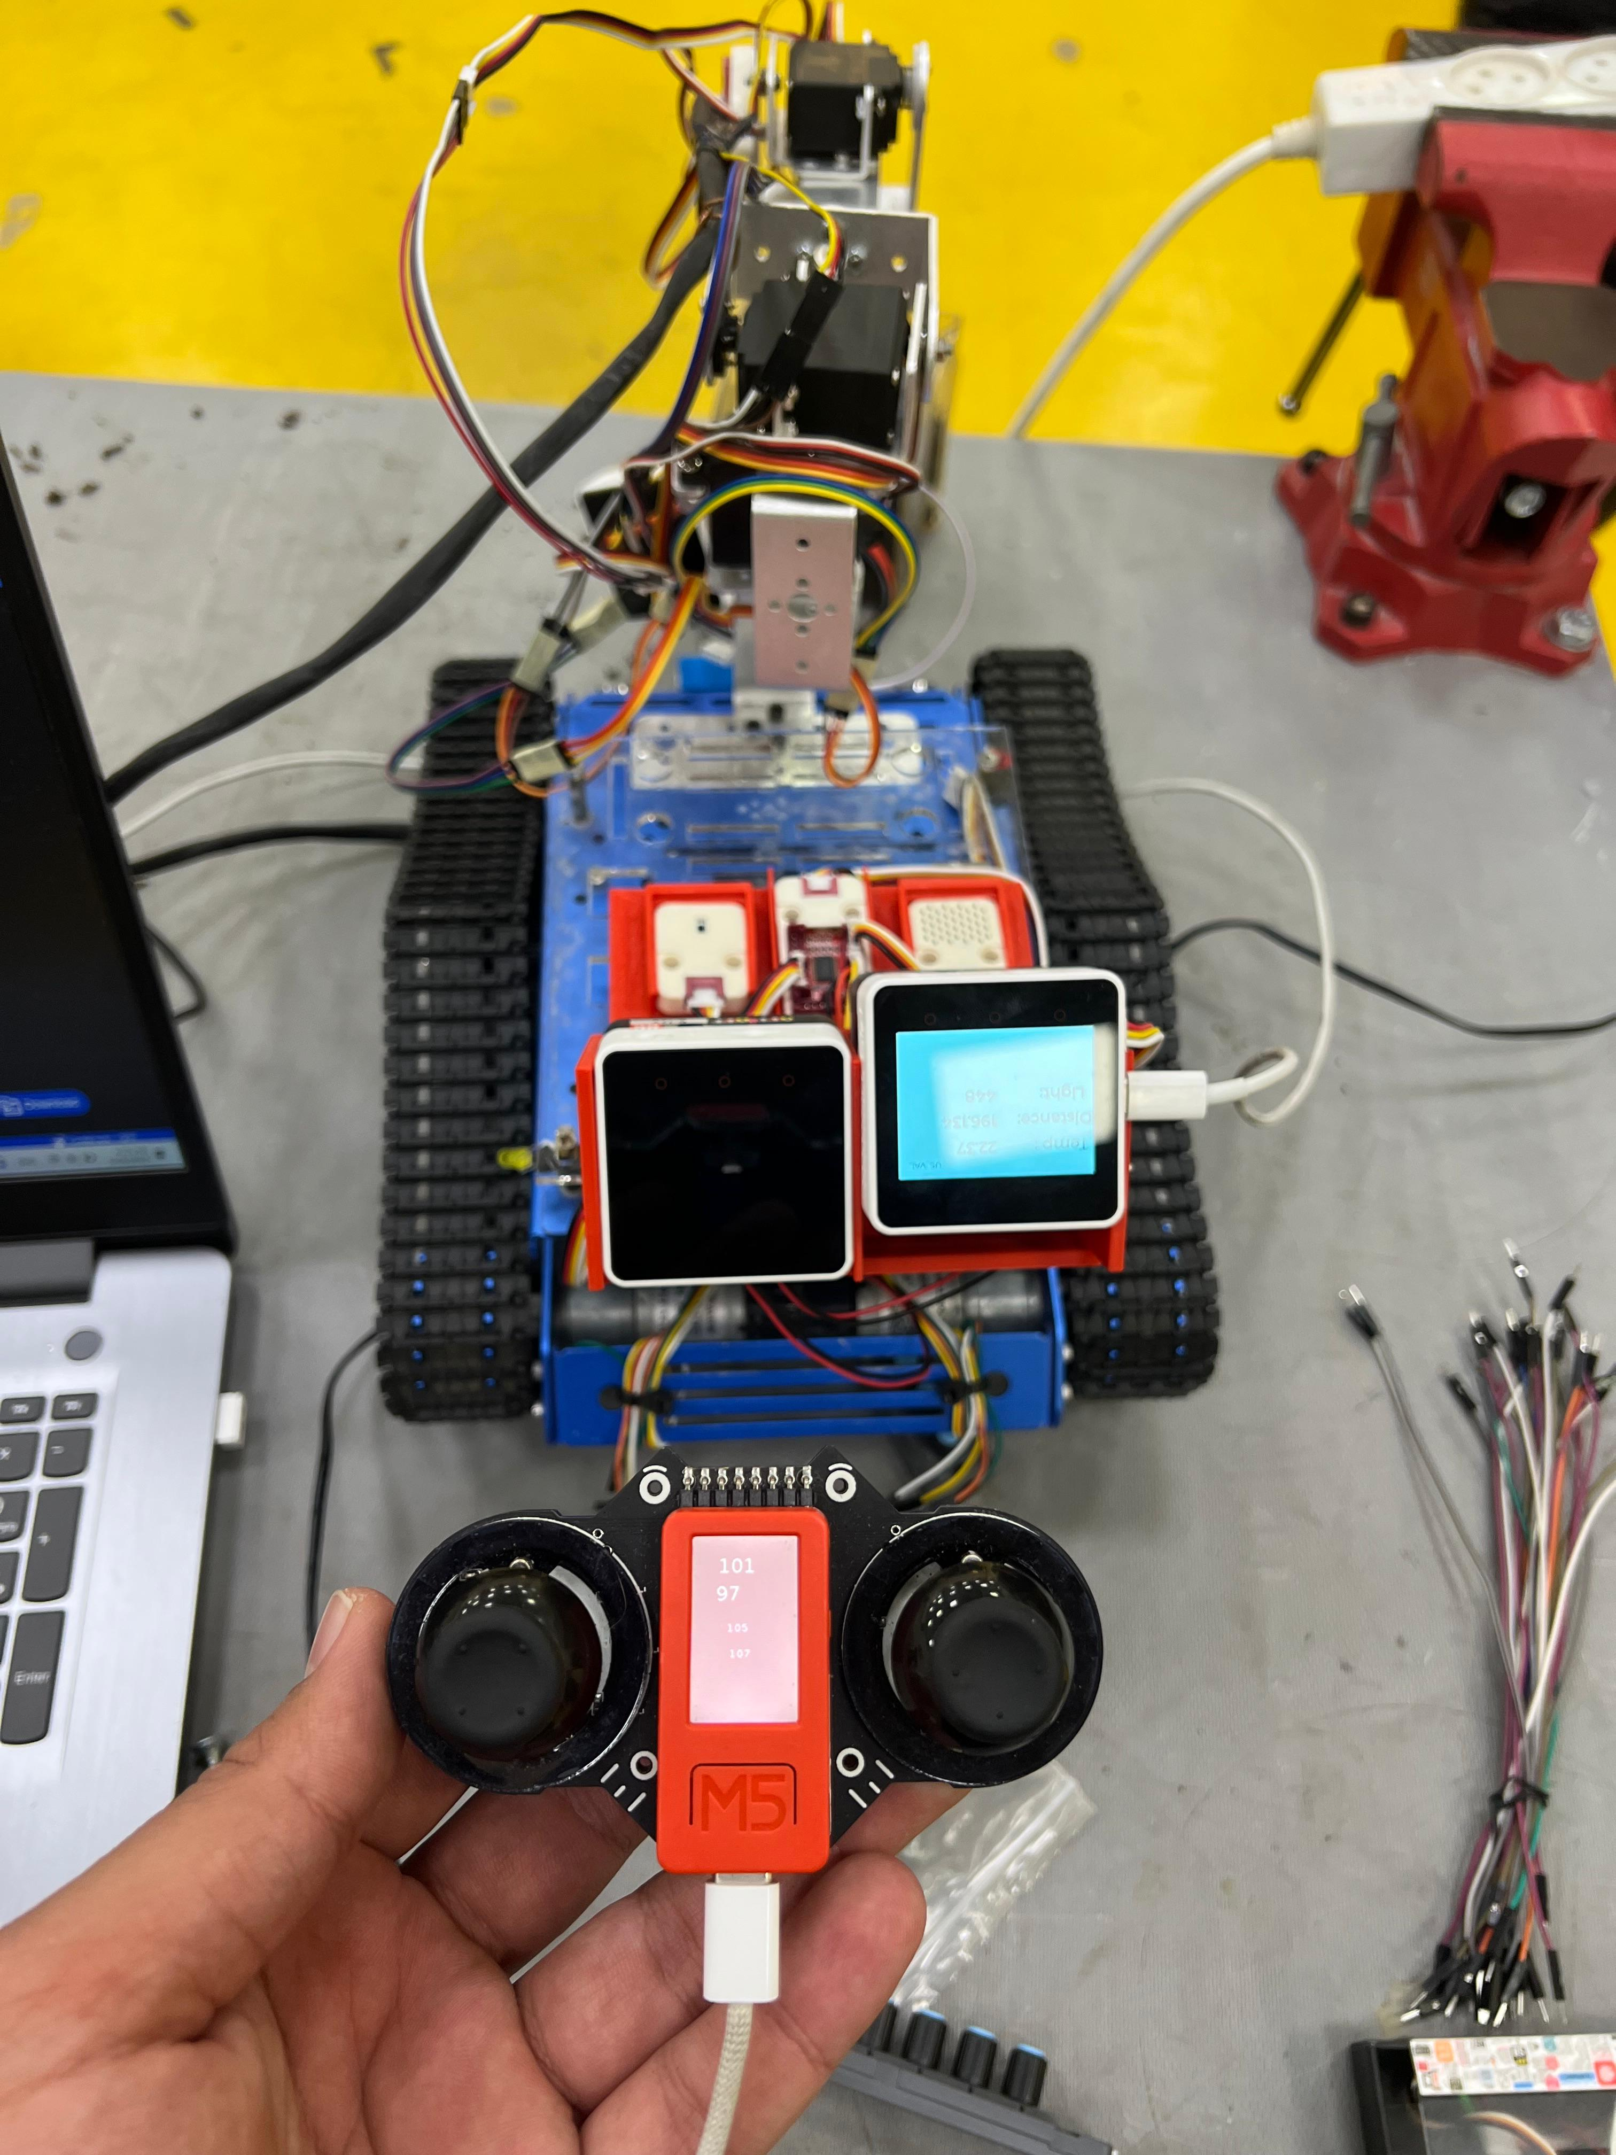
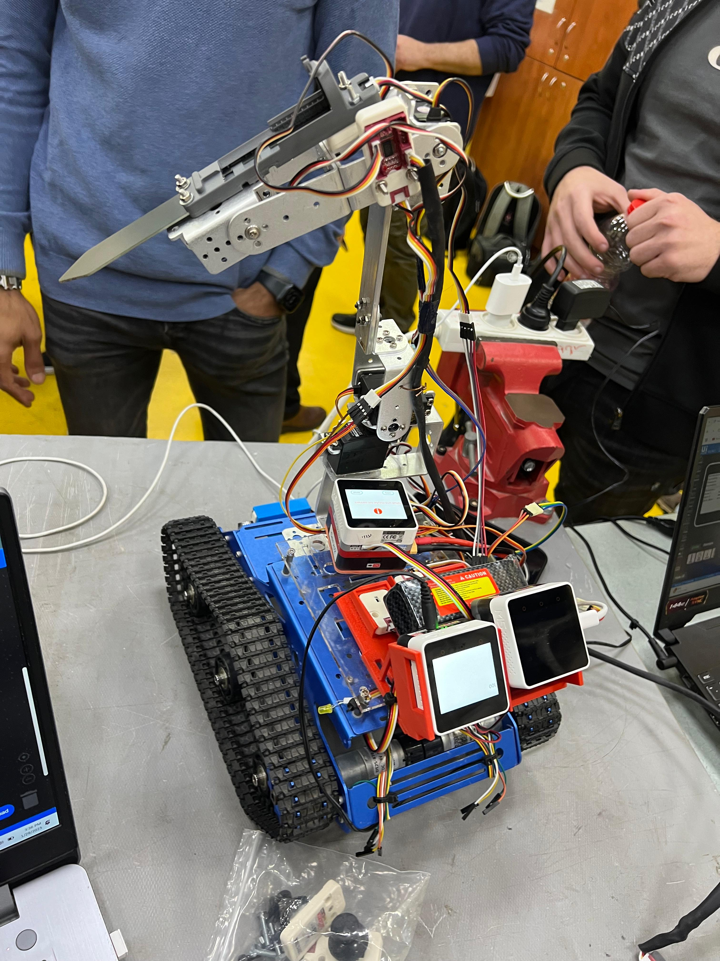
Mechanical POV
10
Bottom left controller is for the joystick.
Bottom right is for sensors its handled via mqtt.
Upper controller is for the handle.
The robot stabs the humidity sensor in the soil.
Controlled via a joystick.

Slide 12
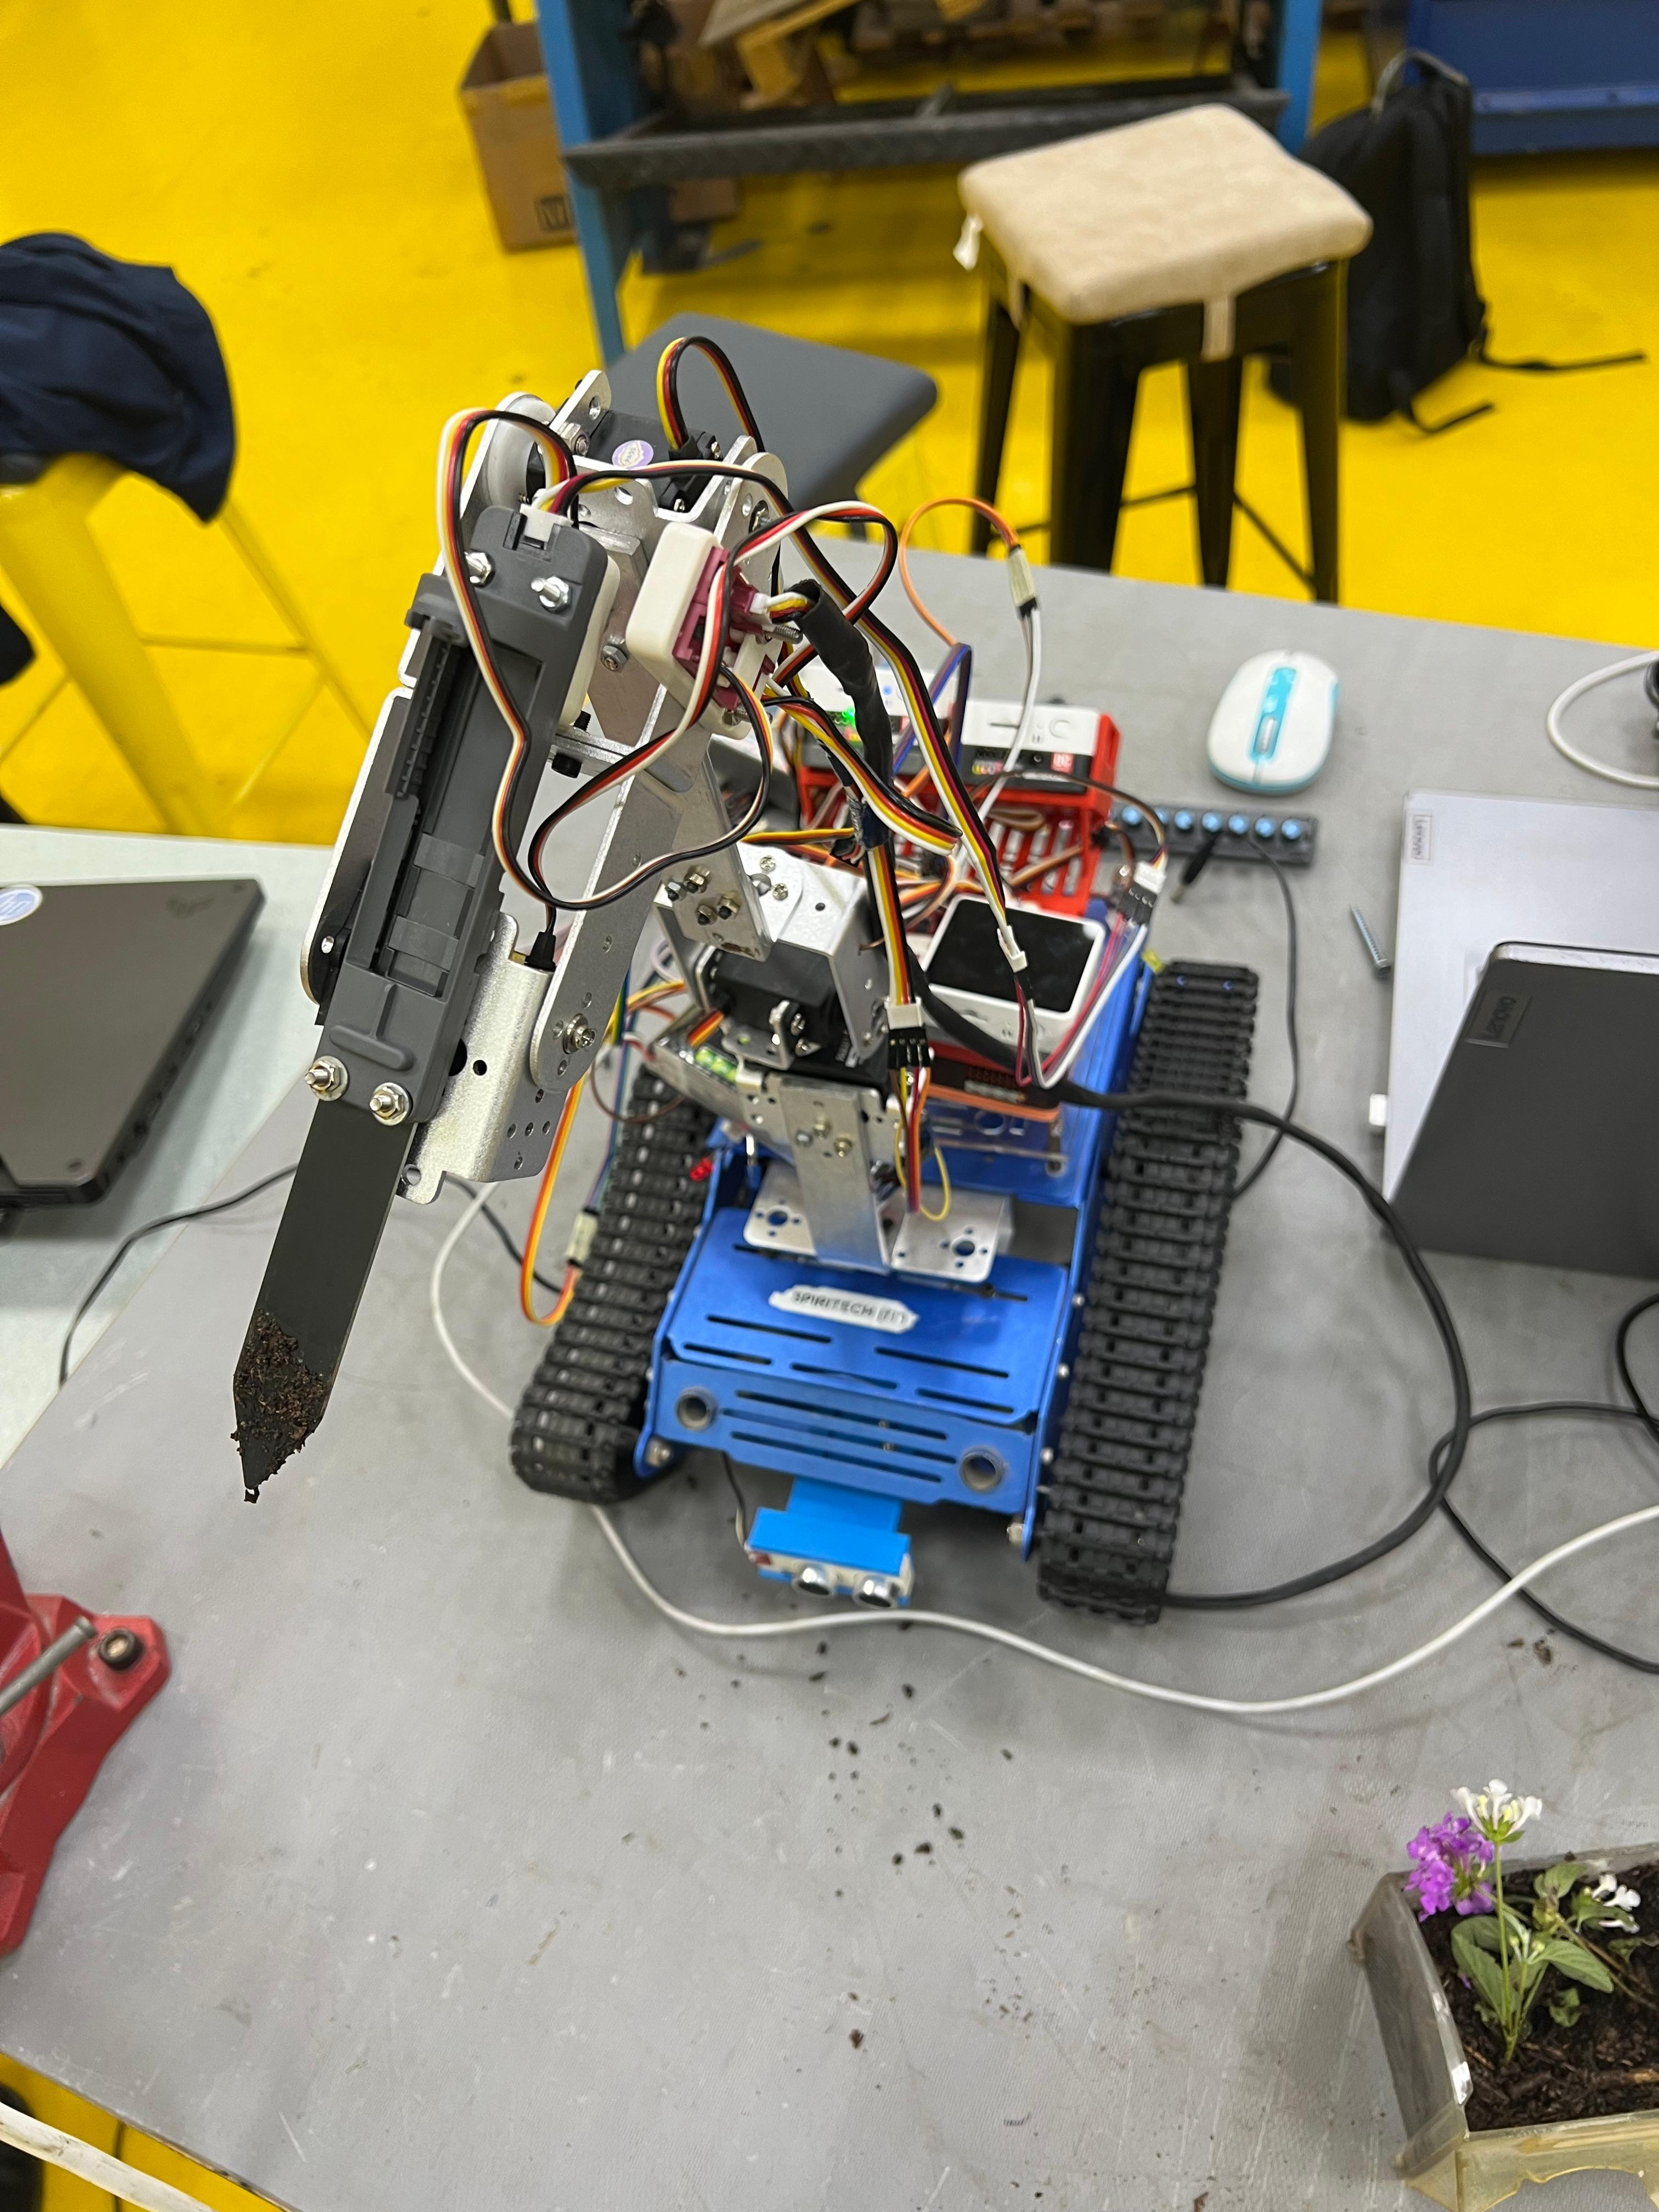


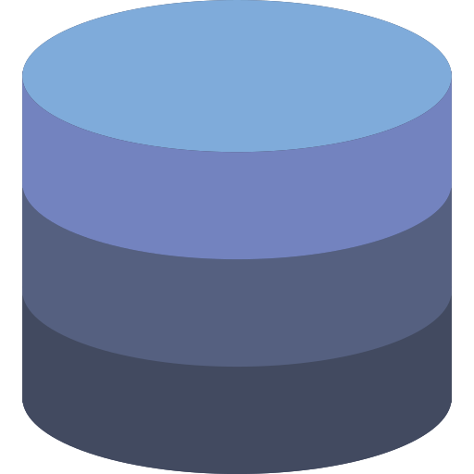





Application Layer Architecture
11
Client side
Cloud MQTT
Server side
(Backend)
WebSocket
Sensors
REST API
Frontend Stack
REST API
Backend Stack
JavaScript
Database
ReactJS
NodeJS
JavaScript
Notes:
A REST API - is a way for two computer systems to communicate over HTTP, for example: web browsers and servers and use of GET, POST, PUT and DELETE actions

Slide 13
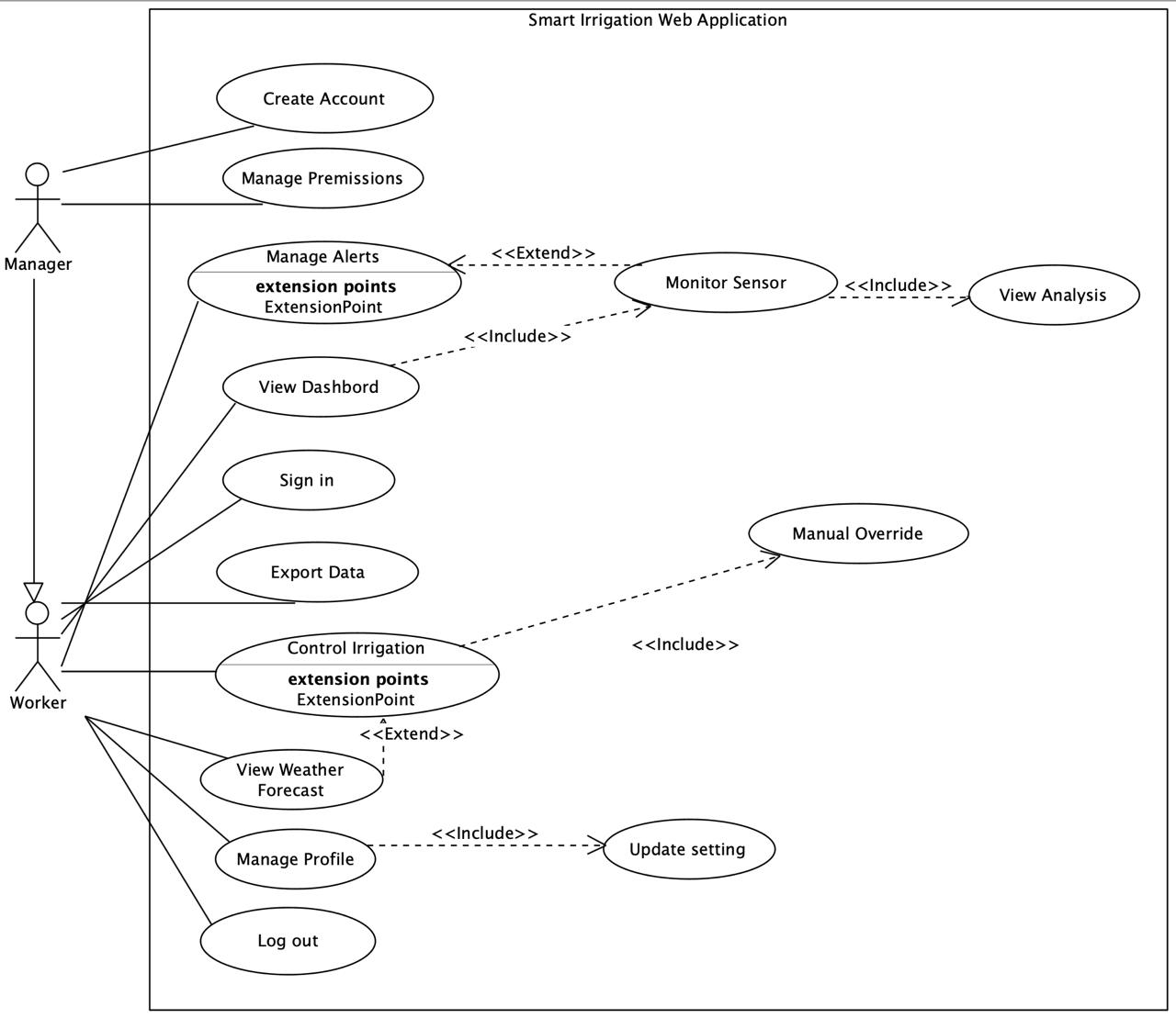
12
Use-Case Diagram

Slide 14
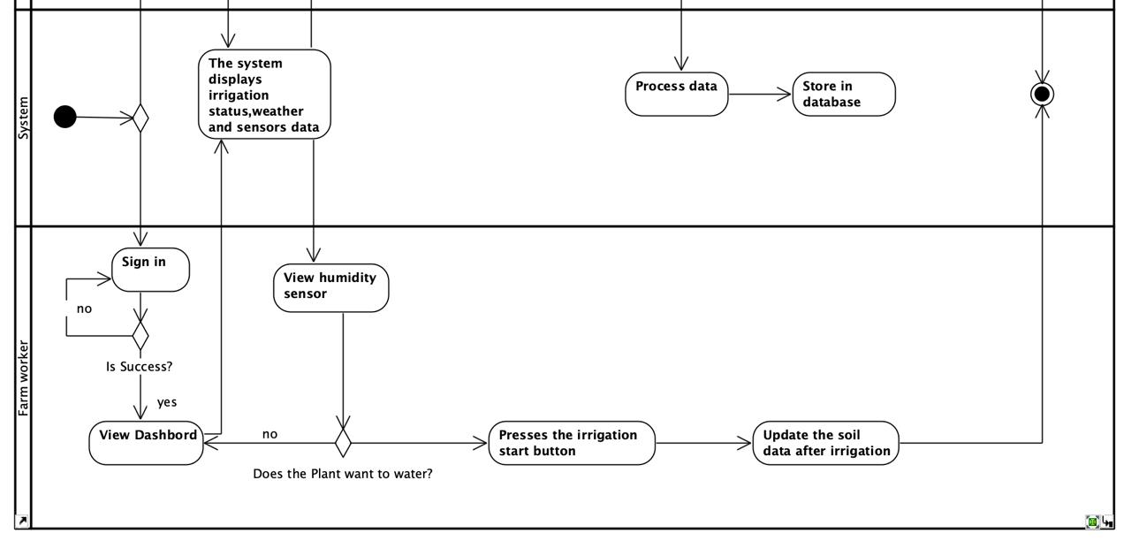
13
Activity Diagram-System & Worker

Slide 15
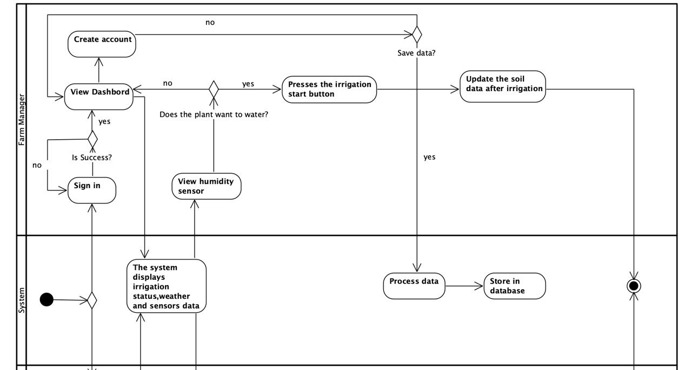
14
Activity Diagram-System & Manager

Slide 16
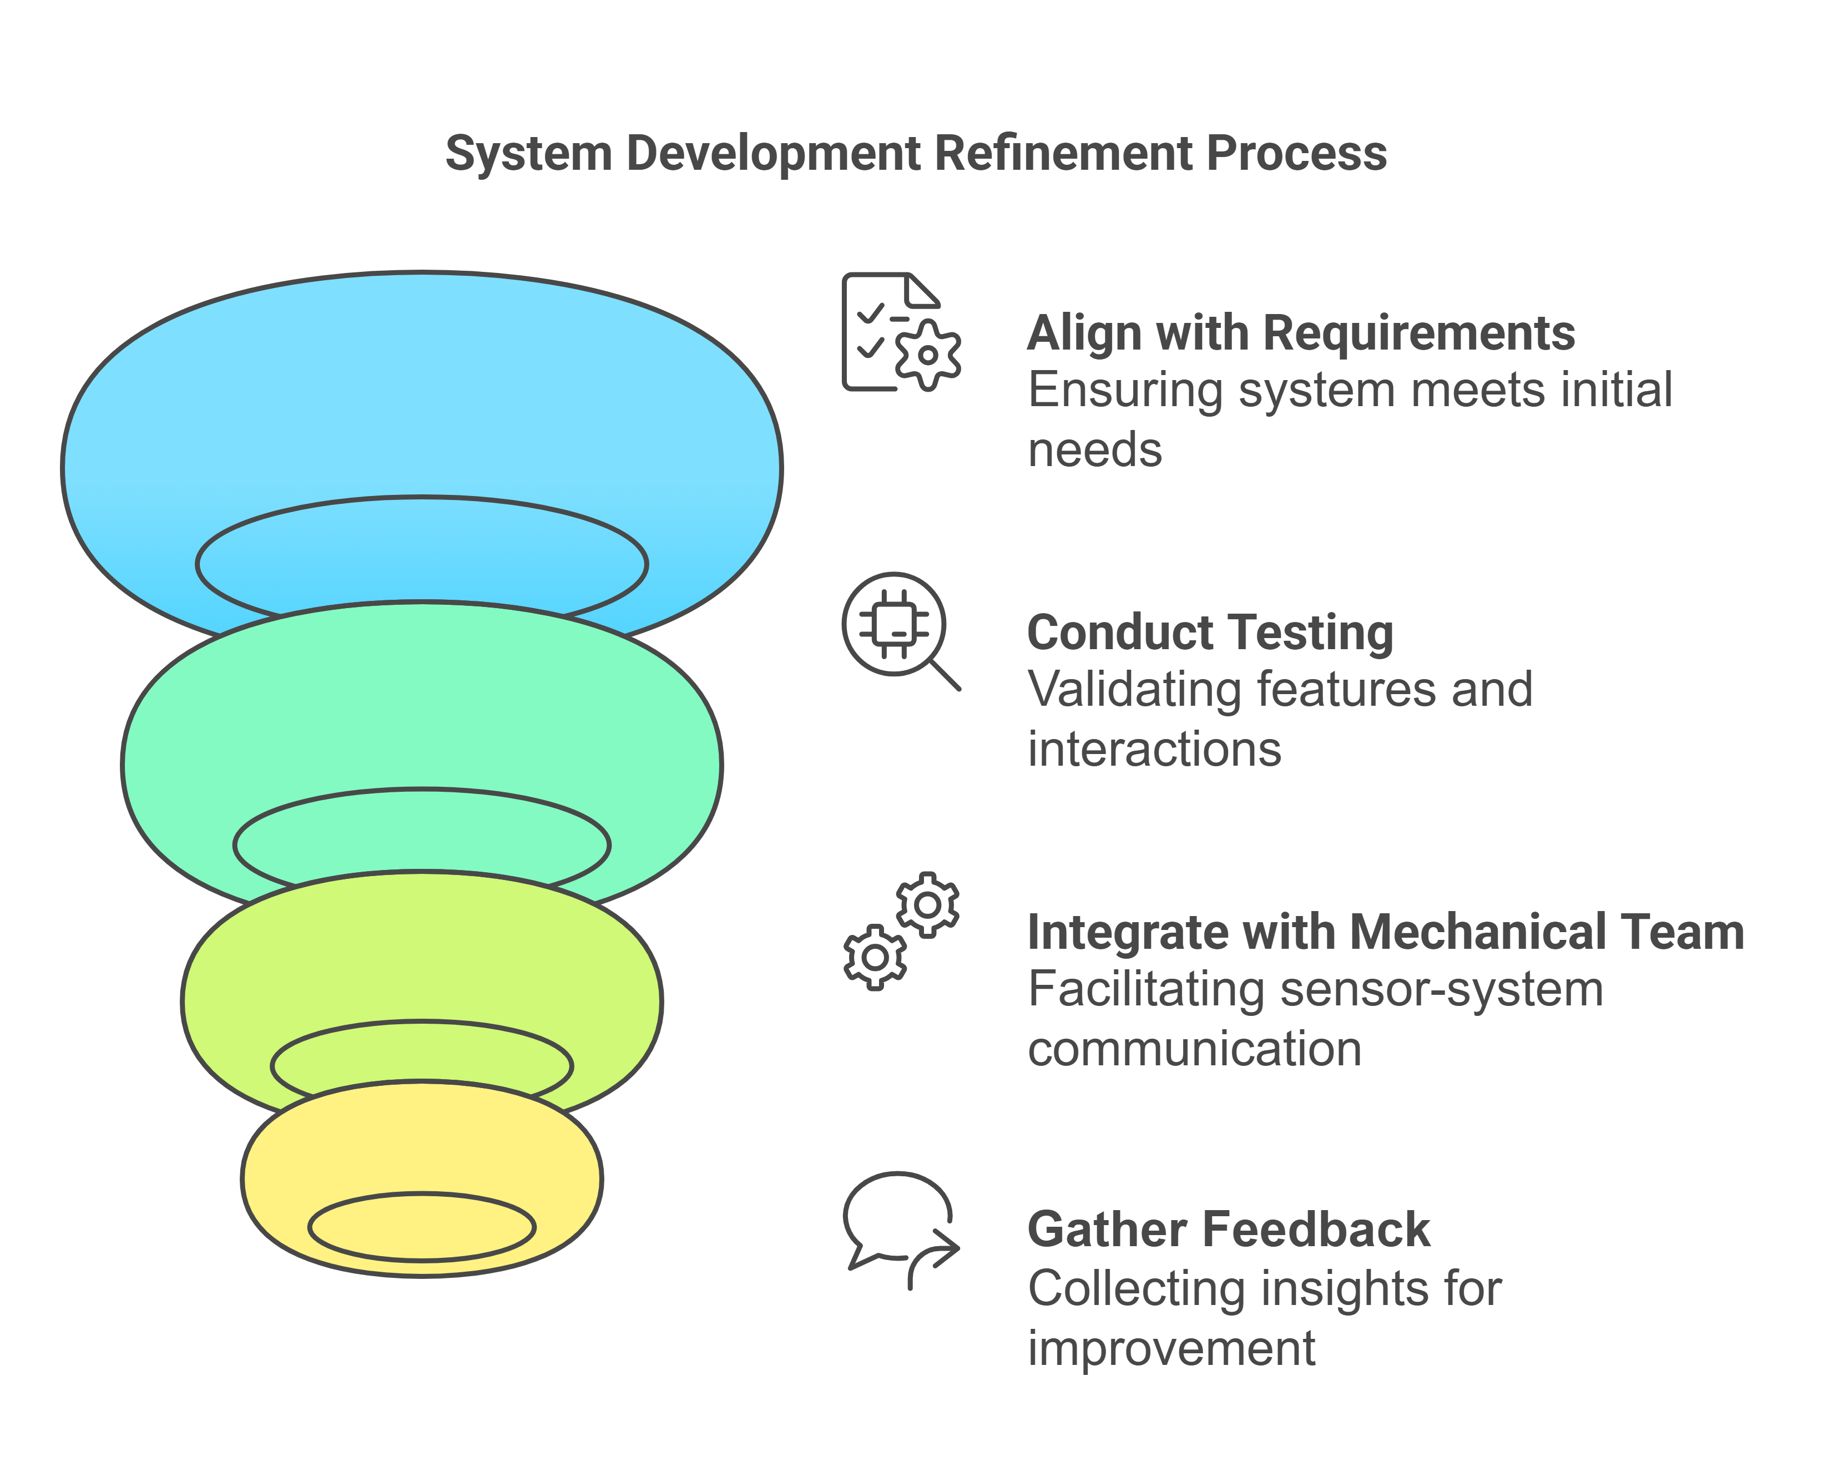
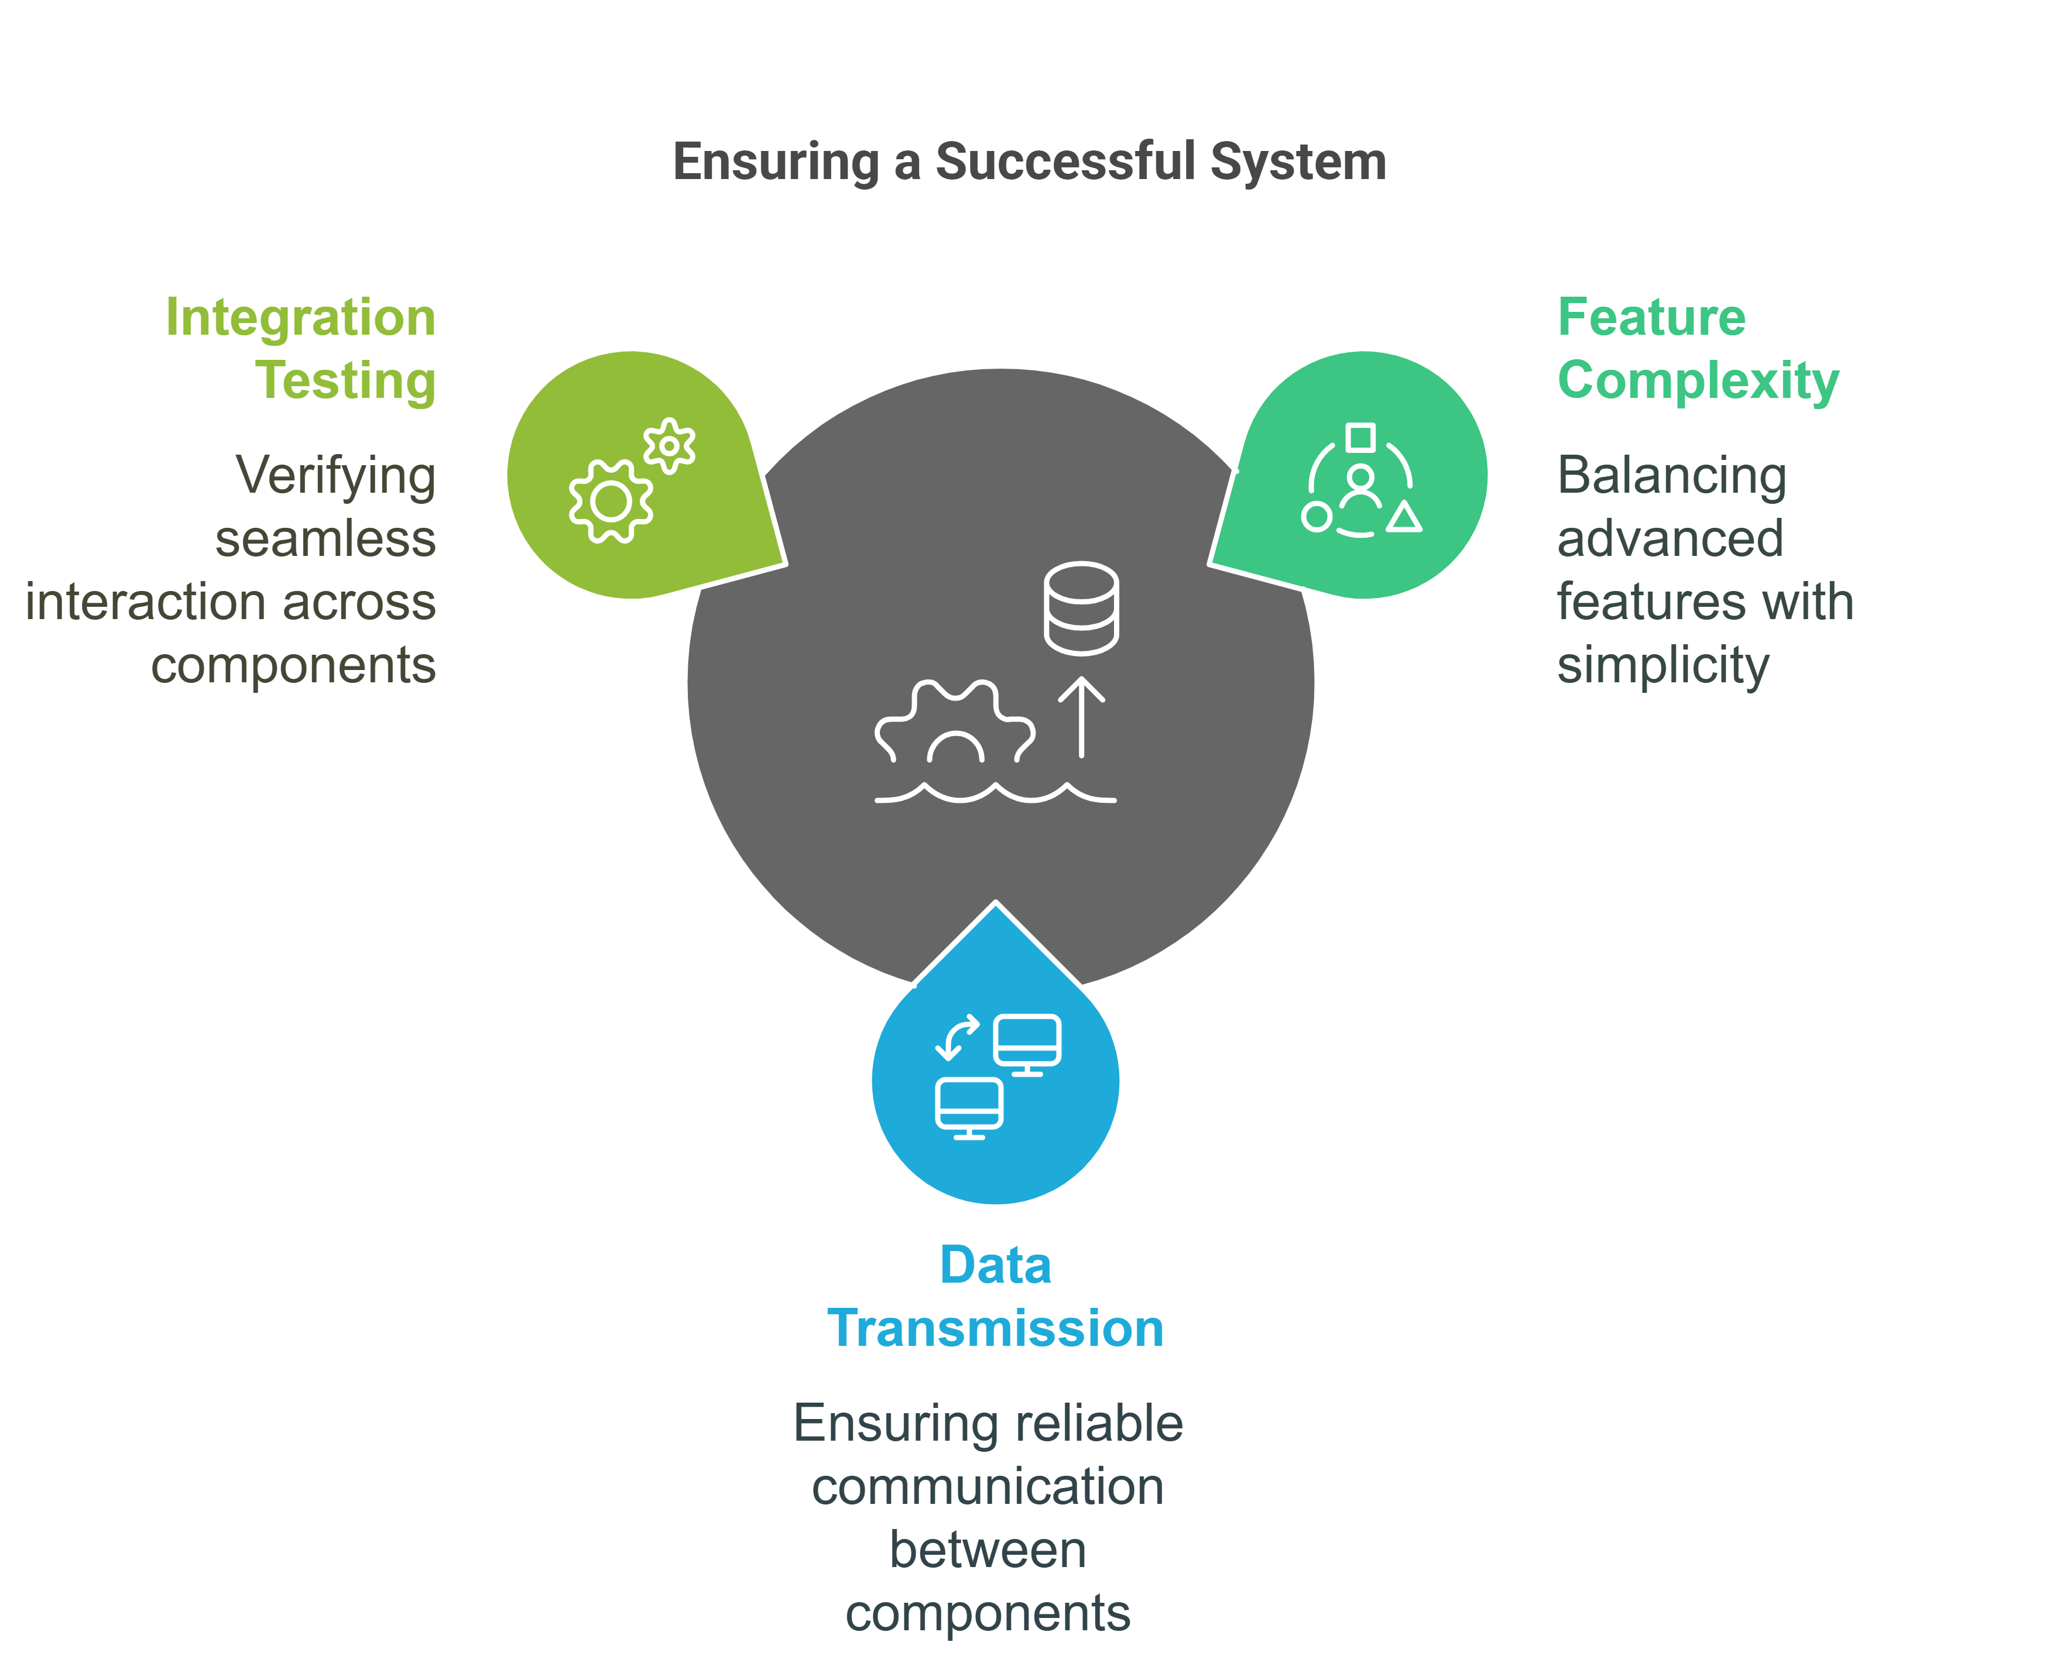
Tests
15
Align with Requirements
Ensuring system meets initial needs.
Unit Testing
Acceptance Testing
Conduct Testing
Validating features and interactions.
Integrate with Mechanical Team
Facilitating sensor-system communication.
Gather Feedback
Collecting insights for improvement.
System Testing

Slide 17

16
Project’s Challenges
Testing Real-World Scenarios.
Integration.
Data Transmission.
Time Constraints.
Collaboration.
User Requirements.

Slide 18
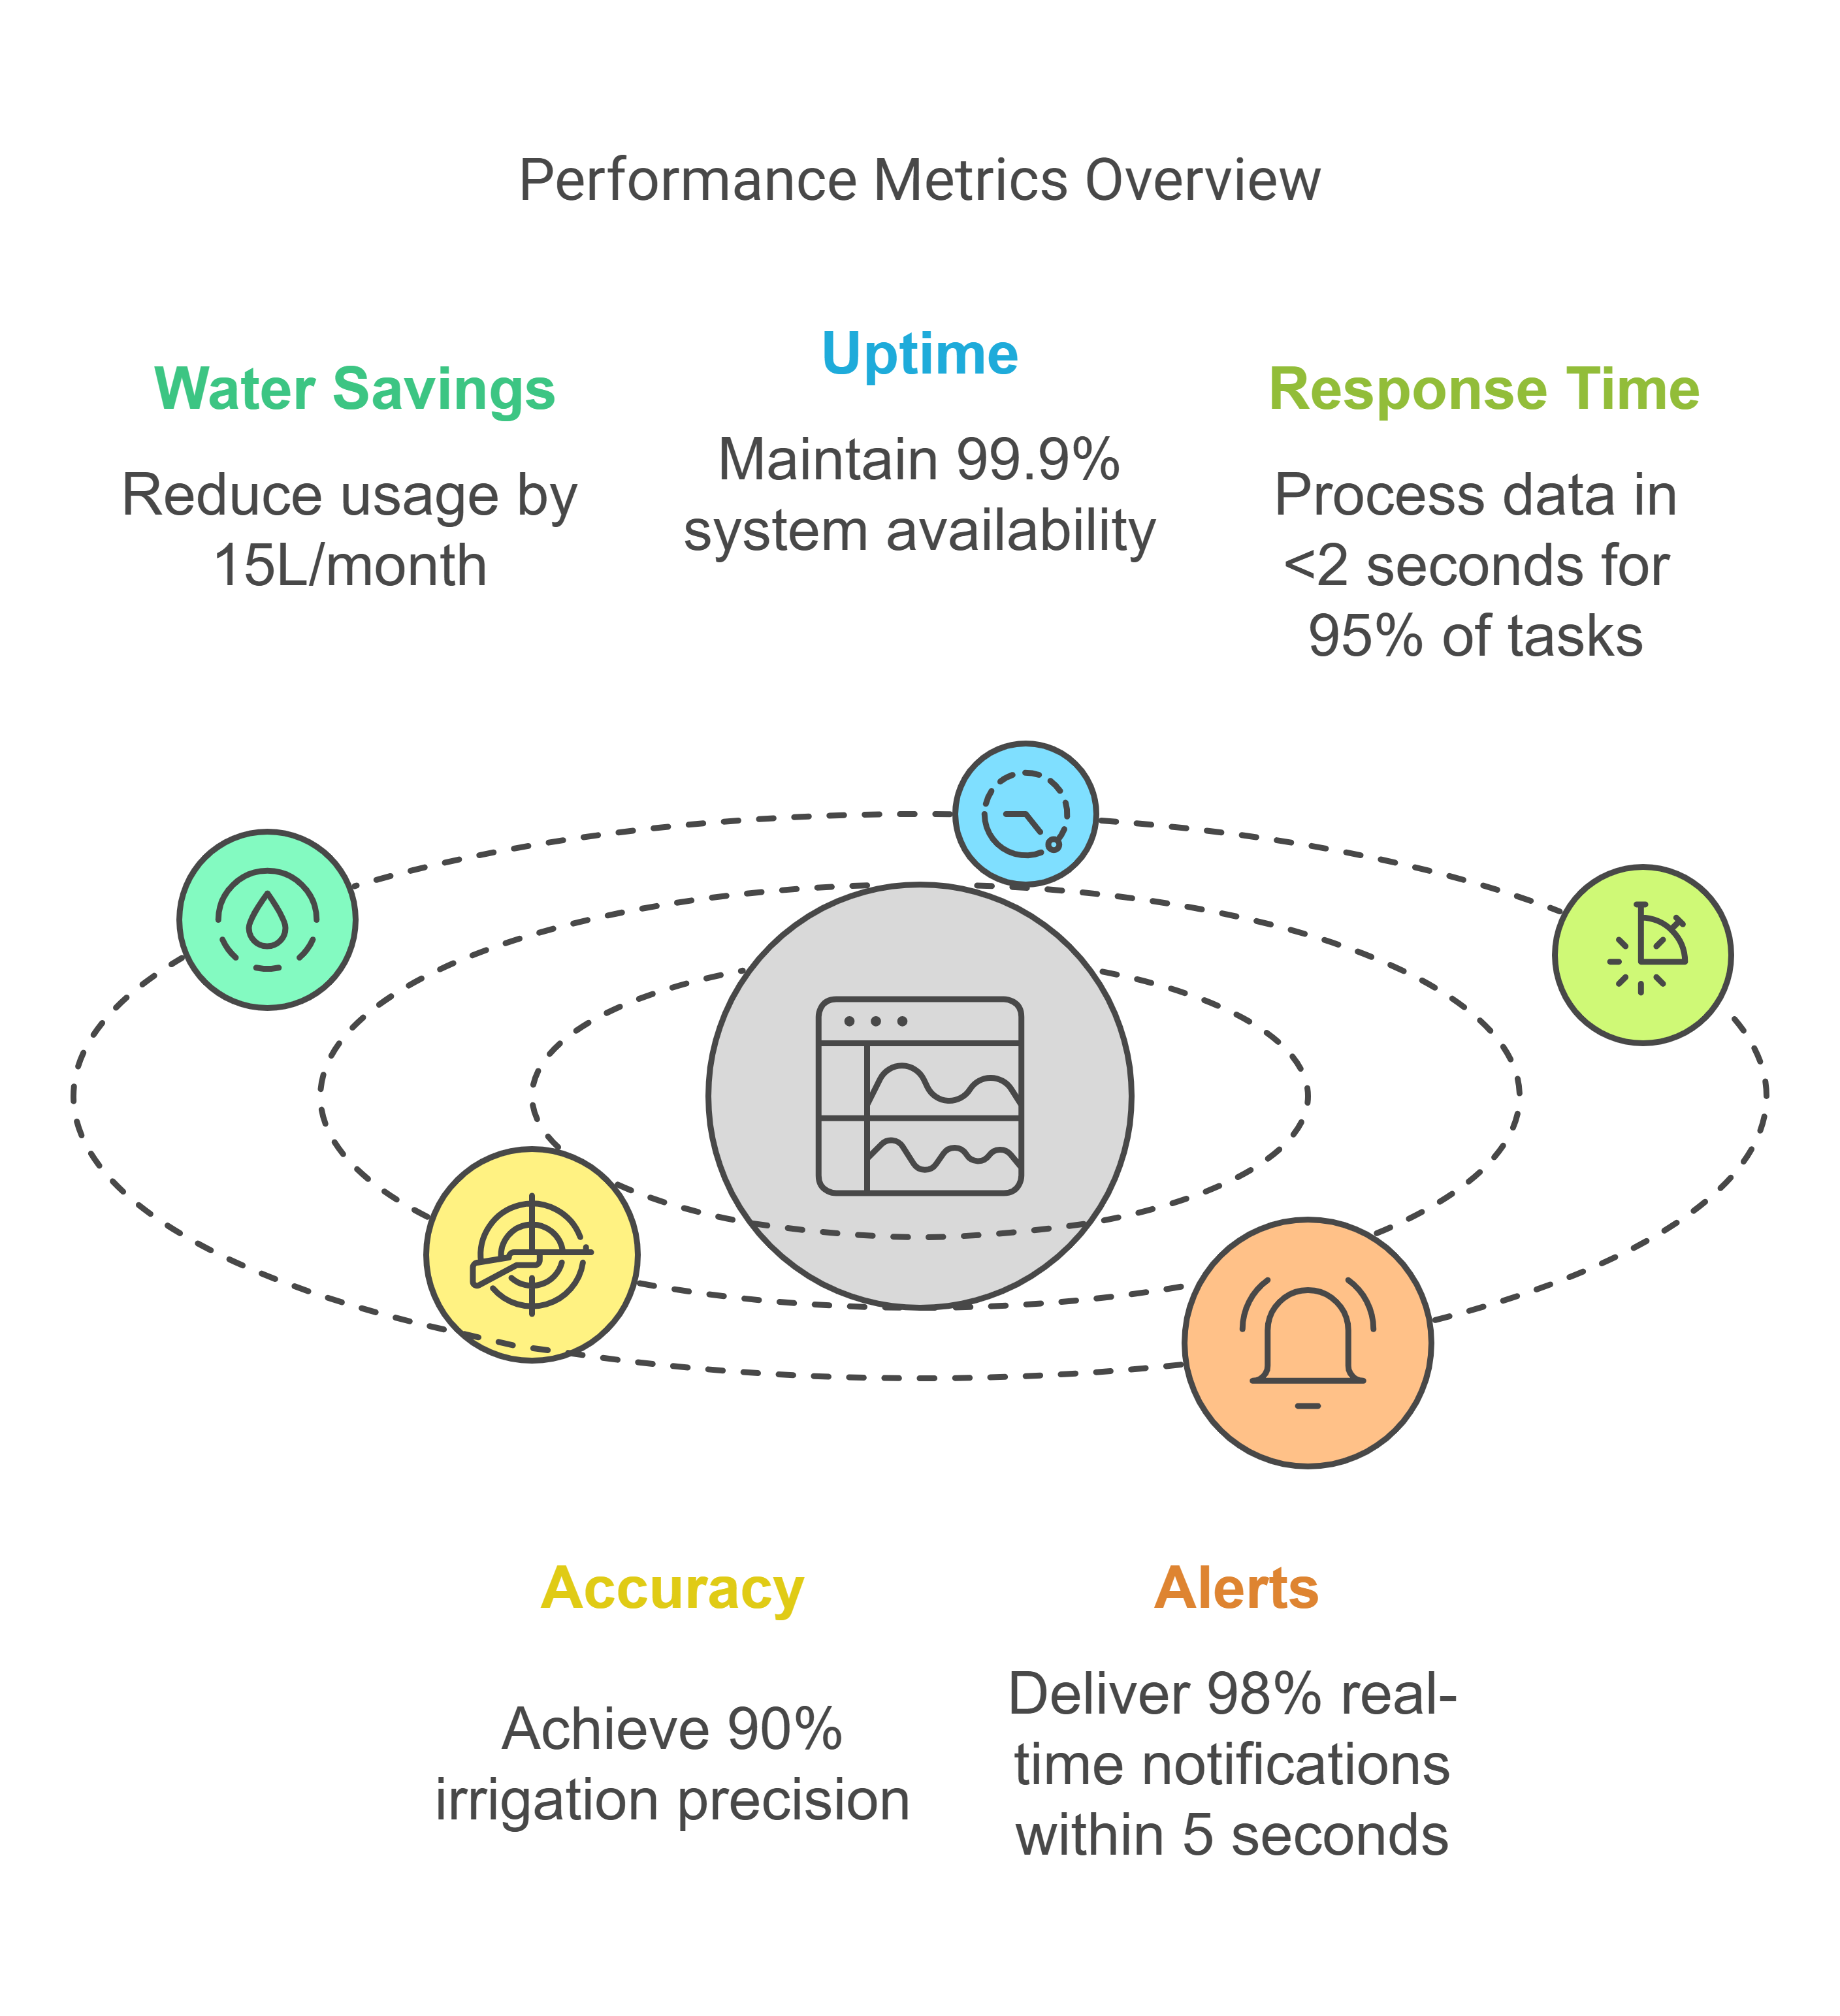
17
Metrics
Uptime
Maintain 99.9% system availability.
Water Savings
Reduce usage by 15L/month.
Response Time
Process data in <2 seconds for 95% of tasks.
Accuracy
Achieve 90% irrigation precision.
Alerts
Deliver 98% real-time notifications within 5 seconds.

Slide 19

"Listening is an act of love; thank you for lending your ears."
– Inspired by bell hooks

